Slide 1


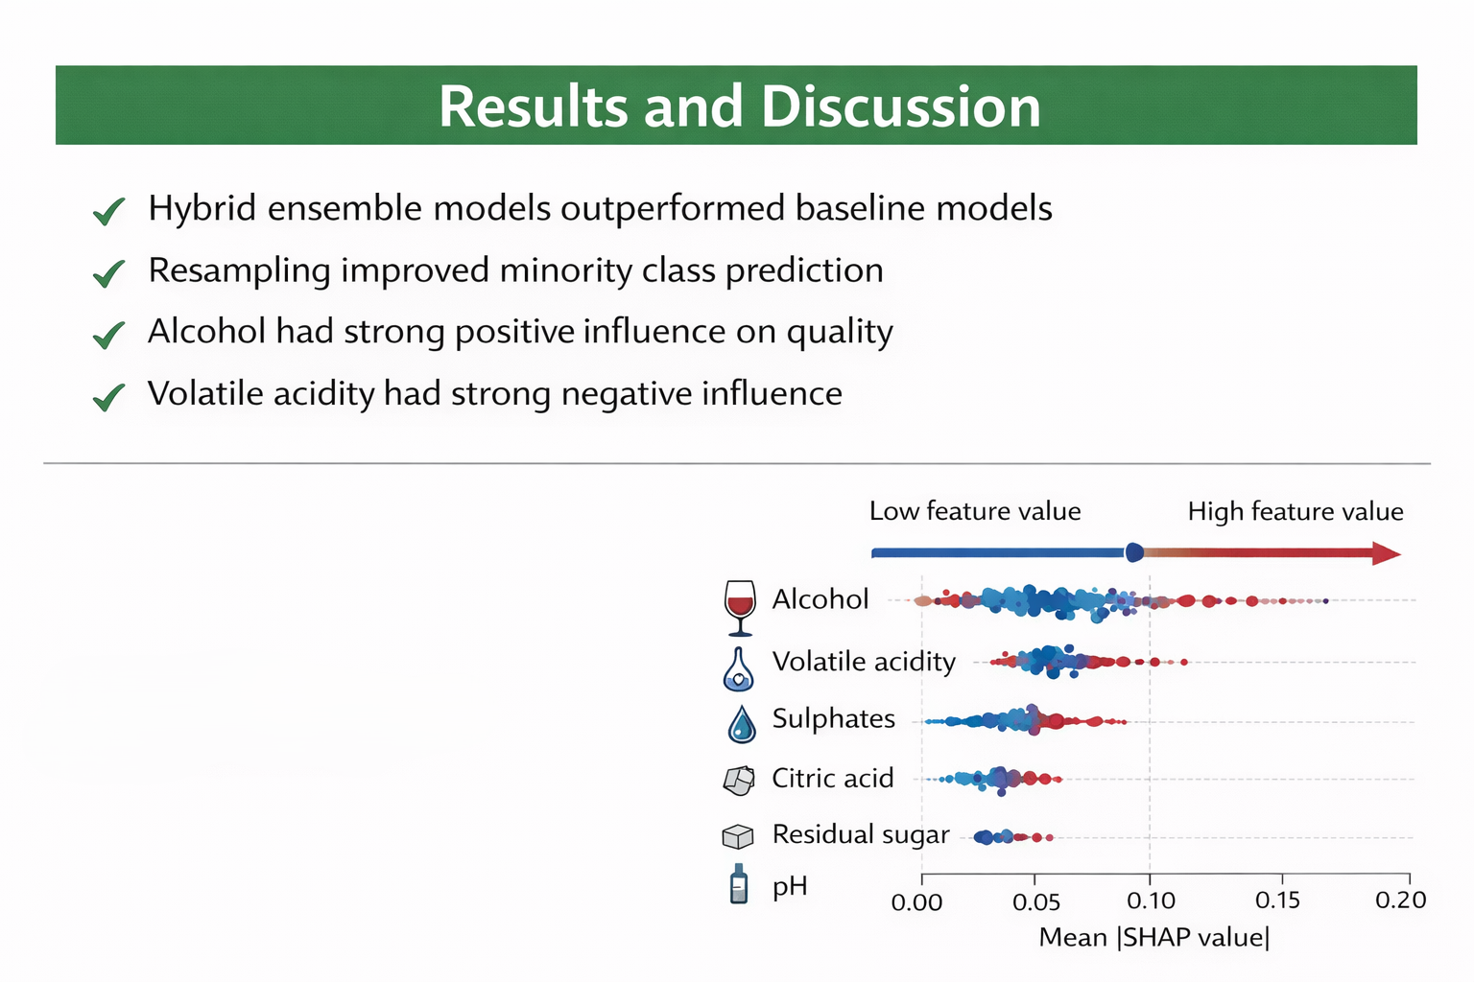
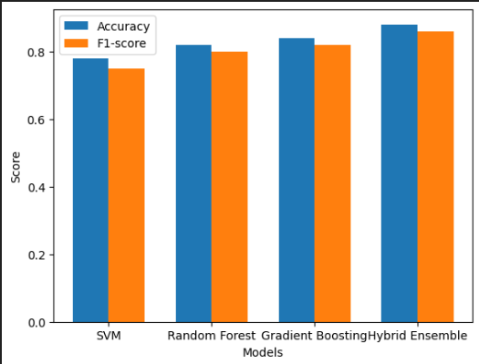
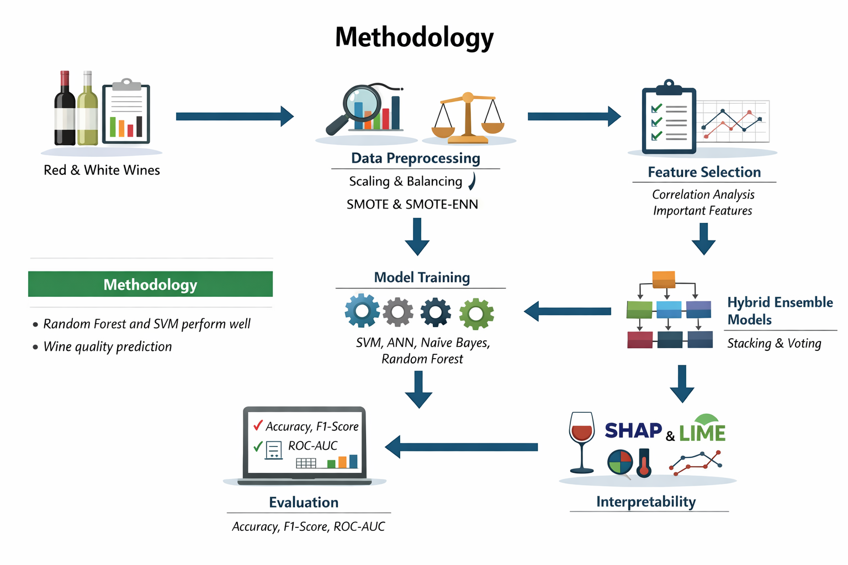
Optimizing red and white wine quality prediction using hybrid ensemble learning and interpretable feature engineering
D.K.H. Dissanayake¹, B.T.G.S. Kumara² ¹Department of Computing and Information Systems, Faculty Of Computing , Sabaragamuwa University of Sri Lanka ²Department of Software Engineering, Faculty Of Computing , Sabaragamuwa University of Sri Lanka
dkhdissanayake@std.appsc.sab.ac.lk
Abstract
The traditional method of assessing the quality of wines is based on the subjective sensory evaluation which is hard to scale. This paper suggests a hybrid ensemble learning model which consists of a classification, regression and interpretable feature engineering. On the example of red and white wine data and resampling methods, the suggested models are superior to the baseline methods. SHAP and LIME indicate that alcohol is a positive and volatile quality contributor, and the opposite is also true (liquid acidity).
Keywords : Feature Engineering, Hybrid Ensemble Learning, Machine Learning, Model Interpretability, Wine Quality Prediction
Introduction
Competitive wine production requires wine quality forecasting.
Conventional methods of sensory evaluation are subjective and unreliable.
Machine learning can predict objective quality through the use of physicochemical data.
The presence of models that are not interpretable and poor class imbalance exists in many existing models.This work is concerned with accuracy, robustness and explainability.
Literature Review
Random Forest and SVM perform well in wine quality prediction. Ensemble and hybrid models improve accuracy, but often lack interpretability. SHAP and LIME enhance transparency, yet few studies combine ensembles, resampling, and explainability.
Results and Discussion
Hybrid ensemble models had greater accuracy and better prediction on minority classes. The findings of the research were also similar between red and white wine where alcohol and volatile acidity had a positive and negative impact on quality which positively contributed to model interpretability and utility.
Fig. 2.Results and Discussion Fig. 3. Model performance comparison
Methodology
There were public datasets of red and white wine.
Class imbalance was found during exploratory data analysis.
Scaling and resampling were done with SMOTE and SMOTE-ENN.
Correlation analysis and model-based importance was used to select the features.
The baseline models consisted of SVM, Naive Bayes, ANN, Random Forest and Gradient Boosting.
Stacking and voting techniques were applied in hybrid ensemble models.
Measures of evaluation were accuracy, recall, F1-score and ROC-AUC.
The model interpretability was done using SHAP and LIME.
Fig. 1.
Conclusion
Overall, the study demonstrates that hybrid ensemble learning combined with interpretable feature engineering provides accurate and transparent wine quality prediction. The proposed framework bridges predictive performance and practical usability, enabling informed decision making for winemakers. These findings support the wider adoption of explainable machine learning models in real-world wine production and quality assessment.
Hybrid ensemble learning improves wine quality prediction.
Interpretable feature engineering enhances model transparency.
The framework supports practical decision-making in wine production.
Results encourage adoption of explainable machine learning models.
Future work can include sensory data and aging effects.
References
[1] M. Basalekou et al., “Measuring wine quality and typicity,” Beverages, vol. 9, no. 2, 2023. [2] A. S. Gawale, “Wine quality prediction using machine learning,” 2023. [3] R. T. Hodgson, “Judge reliability in wine competitions,” Journal of Wine Economics, 2008. [4] D. F. Török, “Machine learning for predicting wine quality,” 2023. [5] Q. Zeng, “Prediction of wine quality using ensemble learning,” 2022.
Computing Undergraduate Research Symposium (ComURS2026)
Faculty of Computing
Sabaragamuwa University of Sri Lanka
Acknowledgements
The author gratefully acknowledges Prof. B.T.G.S. Kumara for guidance and supervision. Thanks are also extended to the Faculty of Computing, Sabaragamuwa University of Sri Lanka.

